Slide 1
Road freight transport transition to zero-emission
views of Europe’s Commercial vehicle manufacturers
24 June 2026
Thomas Fabian
Chief Commercial Vehicles Officer

Slide 3
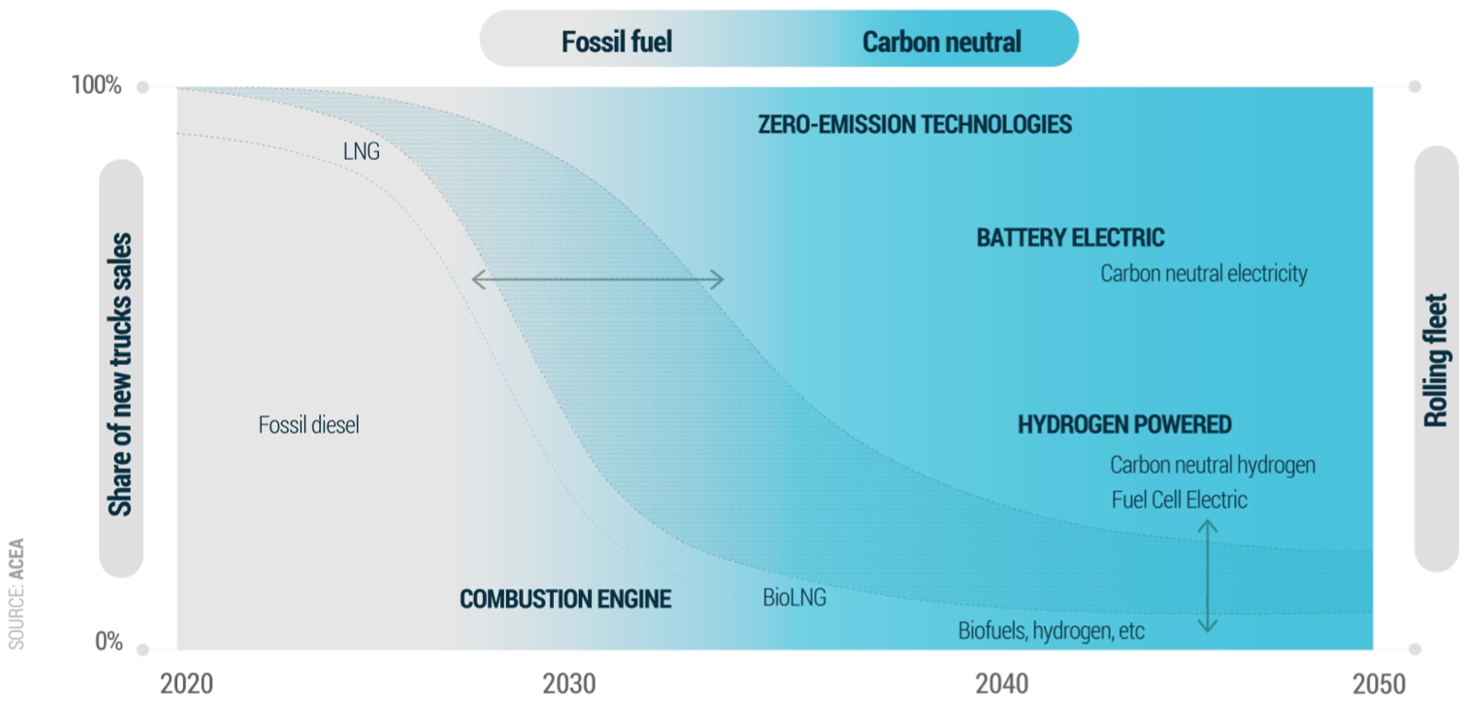
HDV Decarbonisation PatHway
Fossil-Free by 2040

Slide 4
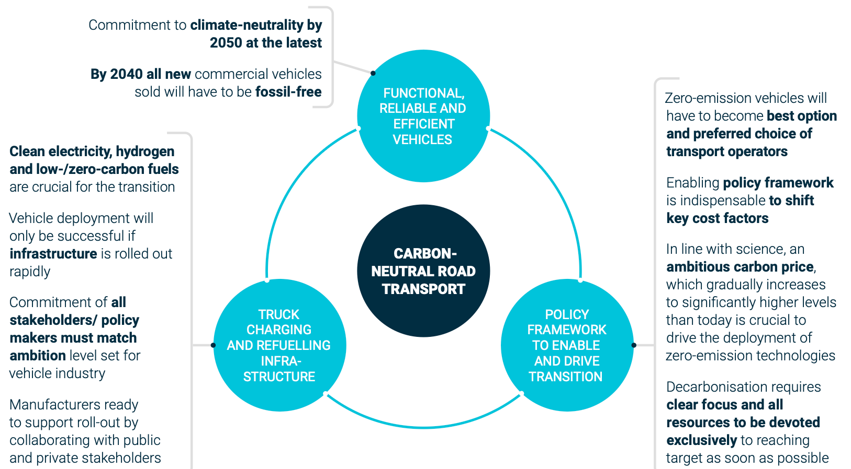
THREE KEYS TO ZERO-EMISSION ROAD TRANSPORT

Slide 5
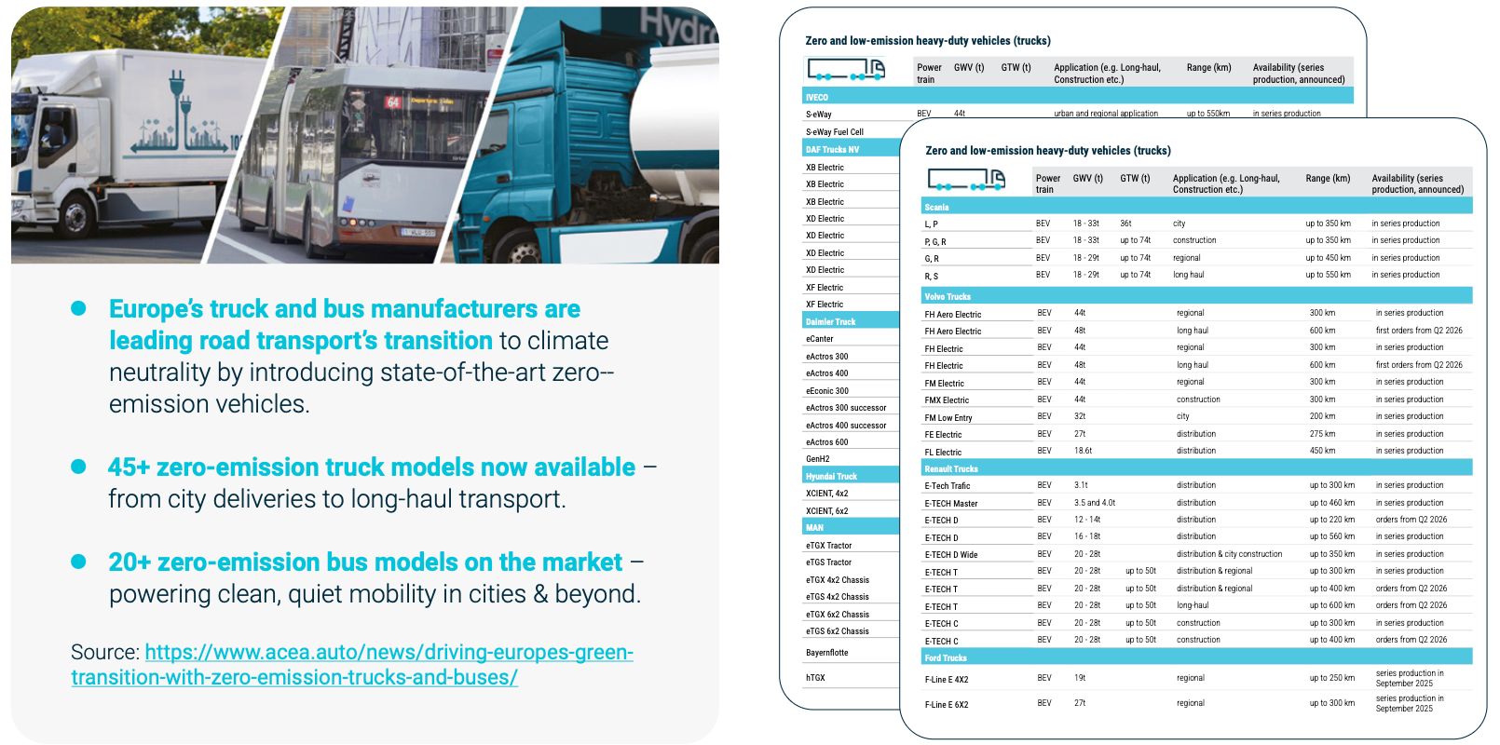
DRIVING EUROPE’S GREEN TRANSITION WITH
ZERO-EMISSION TRUCKS AND BUSES

Slide 6
The perfect storm
Industrial competitiveness and resilience
Increasing global pressure
Decarbonisation
Limited market uptake of European low-carbon industrial products
Insufficient demand-side incentives and business cases
A coordinated approach to manage the transition:
stimulate demand, secure supply chains, accelerate deployment
Products are available but not scaling
Investment uncertainty and insufficient enabling conditions
Strategic dependencies in key sectors and technologies
Exposure to external shocks and global competition

Slide 7
ZEV Market SnapShOT
Q1 2026: 2.3% HDV, 16.2% MDV

Slide 8
Europe’s ZEV Market
(2025) A Three-Speed Transition
🇳🇱 NL 9,3%
🇸🇪 SE 7,5%
🇩🇰 DK 6,6%
🇦🇹 AT 5,9%
🇬🇷 GR 3,4%
🇩🇪 DE 2,6%
🇧🇪 BE 2,5%
🇫🇮 FI 2,3%
🇫🇷 FR 2,2%
🇳🇴 NO 9,8%
🇨🇭 CH 15,2%
🇳🇱 NL 67,0%
🇸🇪 SE 62,3%
🇩🇰 DK 55,2%
🇬🇷 GR 30,4%
🇩🇪 DE 13,9%
🇫🇷 FR 11,1%
🇵🇹 PT 11,0%
🇮🇹 IT 11,0%
🇱🇺 LU 10,7%
🇳🇴 NO 48,8%
🇨🇭 CH 42,8%

Slide 9
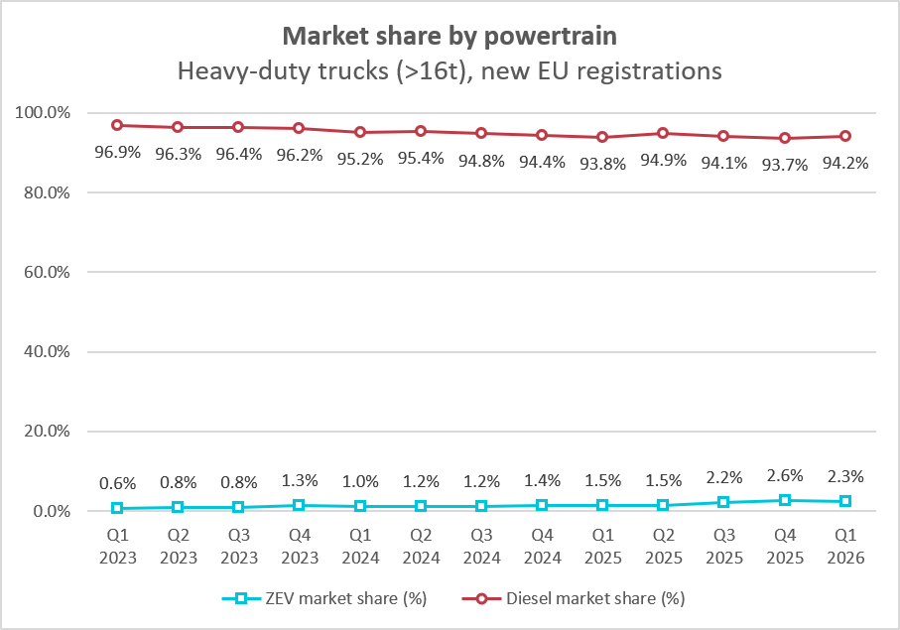
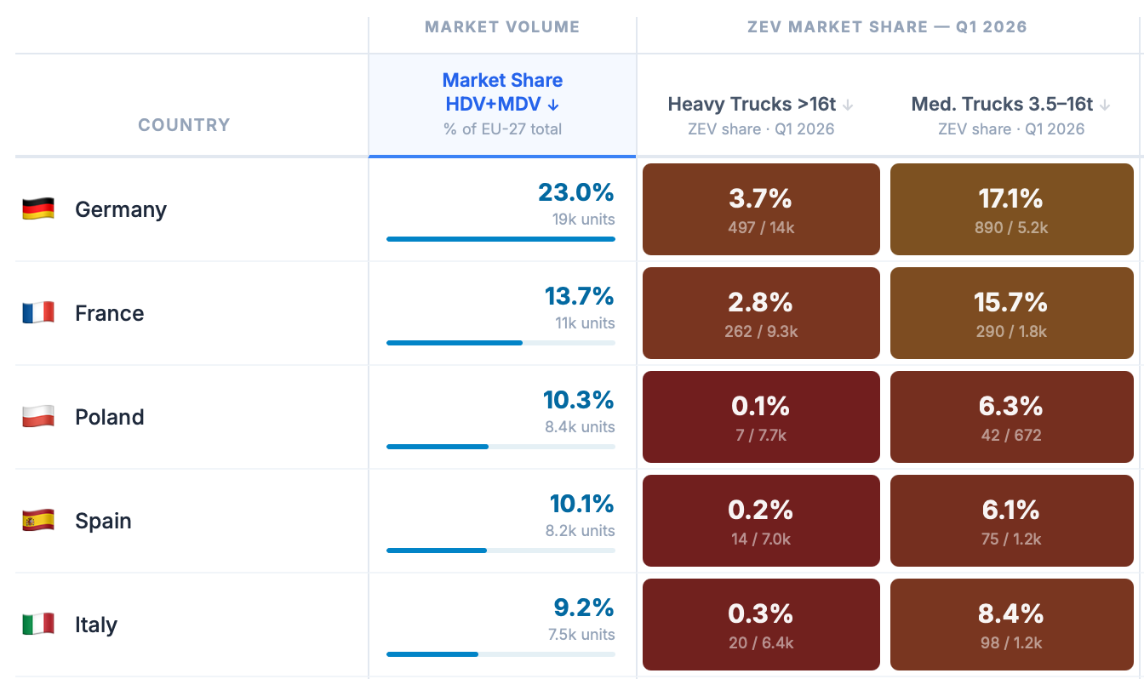
ZEV Transition
Q1 2026: 2.3% HDV, 16.2% MDV

Slide 10
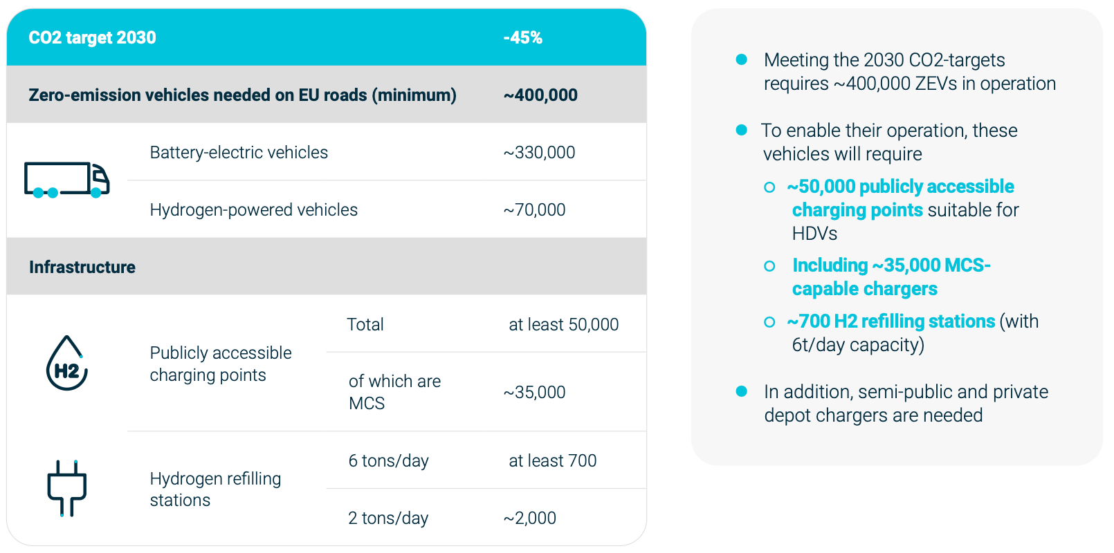
HDV CO2 Targets and InfrasTRUCTURE
Necessary Charging/ Refilling Infrastructure

Slide 11
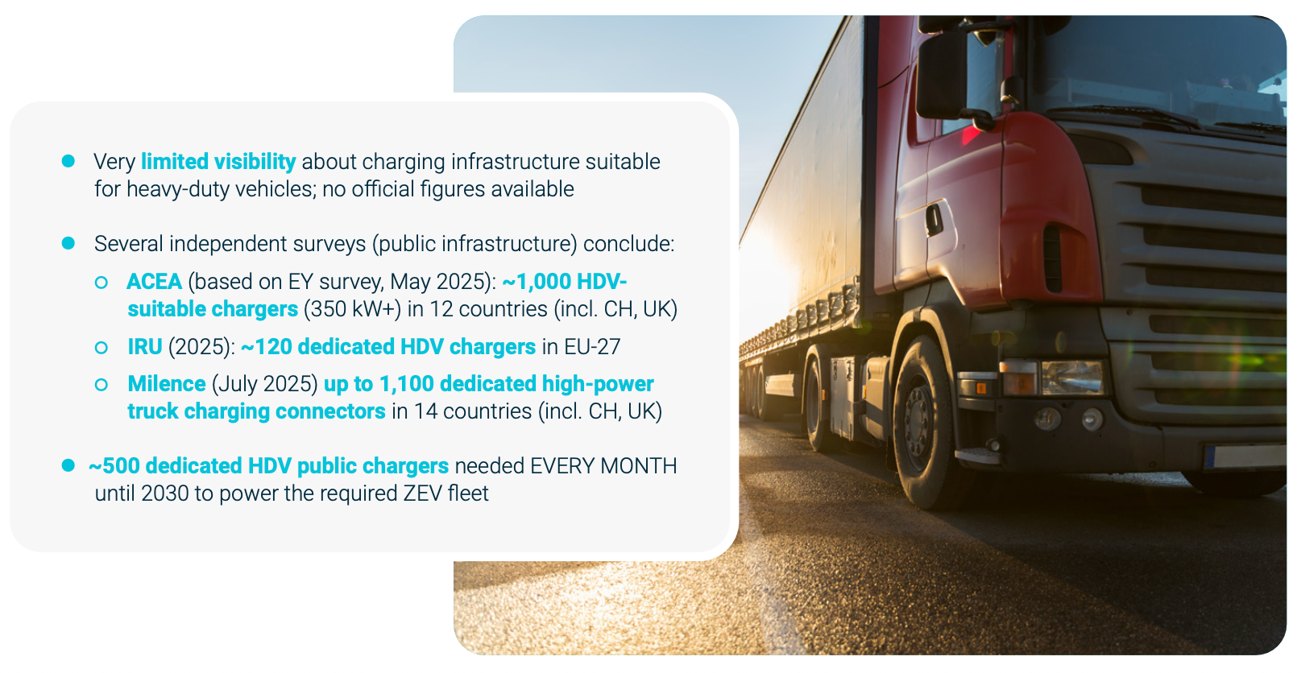
HDV Charging Infrastructure

Slide 12
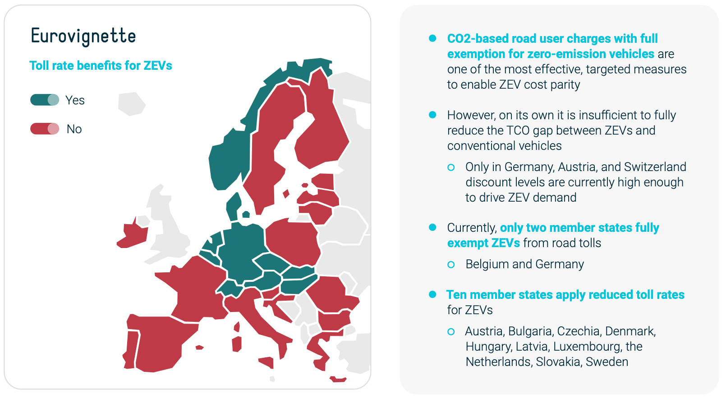
EUROVIGNETTE IMPLEMENTATION

Slide 13
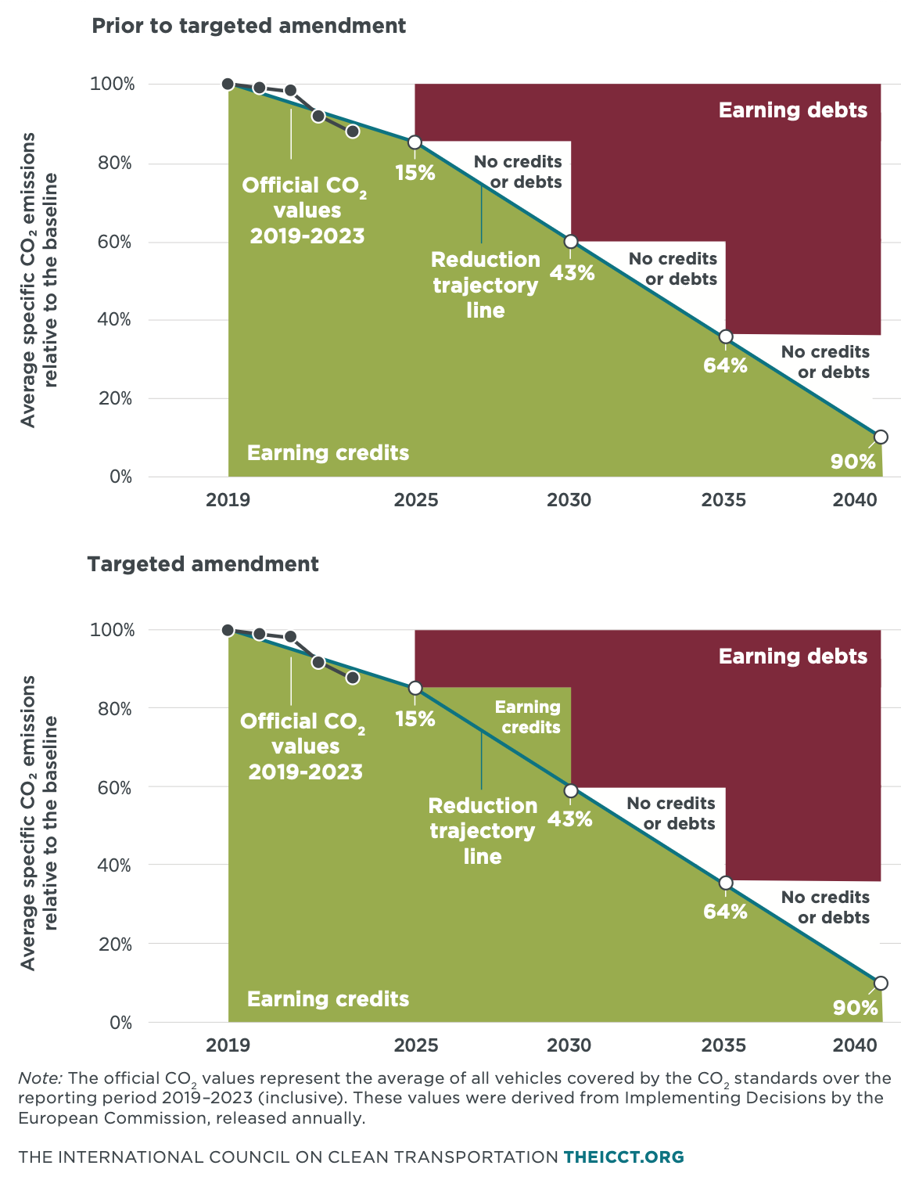
CO2 Standards - Amendment
The recent amendment introduces a limited compliance flexibility for the 2030 target, explicitly recognising delays in key enabling conditions
It corrects a specific design flaw in the current regulatory framework by adjusting the emission credit calculation mechanism.
Manufacturers will only be able to generate credits at all if the enabling conditions improve rapidly and ZEV market adoption accelerates.
It does not
  address the fundamental compliance risk: broader misalignment between increasingly ambitious CO2 targets and delayed enabling conditions.
  address the structural lack of enabling conditions.
  revise or change the HDV CO2 targets

Slide 14
HDV CO2
Status
Targeted amendment to the credit mechanism proposed as part of Automotive Package (16 Dec 2025); final adoption 7 May 2026
HDV CO2 Review scheduled by 31 Dec 2027
  If the timeline is not accelerated, it will likely be concluded ~early/ mid-2029
  Risks for the industry → penalties, financial provisions etc.
Industry pushes for an accelerated review
From the regulator’s perspective, an early review carries risks:
  Creates regulatory uncertainty, distracts from the enabling conditions’ rollout, potential political backlash, re-opens fragile political compromises, risks spillovers from the cars/ vans discussion…

Slide 15
Weights & Dimensions
Legislative Update
Commission
11 Jul 2023: COM proposes comprehensive reform of the Weights & Dimensions Directive
Parliament
12 Mar 2024: Parliament adopts 1st reading position
Council
4 Dec 2025: Council adopts General Approach
Trilogue
2nd trilogue reached provisional agreement on several technical items (vehicle transporters, indivisible loads, the one-stop shop, the EU label for exceptionally long vehicles, and European Modular Systems)
substantial work still required to bridge differences on open political topics (harmonised regime for circulation of 44-tonne vehicles, additional weights for all configurations of zero-emission vehicles)

Slide 16
Weights & Dimensions
ACEA Priorities
ACEA strongly supports the position of the European Parliament
  Higher drive axle limits are essential.
  Weight allowance for 4x2 ZEV tractor-trailer combinations
  Communication of reliable weight data requirements for ZEVs
  Max 18-months transposition timeline
  Additional comments:
    Weight allowance for 5-axle vehicles
    ACEA explicitly rejects Council position that would require ZEVs to transmit weight-related vehicle data to roadside enforcers. This would entail major regulatory and operational risks

Slide 17
🇨🇳
China’s NEV Heavy Truck LARGE Scale Implementation Plan
40%
NEV share of new
HD truck sales
1.6 mln
NEV HDVs on the road
~20% of total HDV fleet
80%
Electrification of
fixed-route, short-haul
in key areas
3,000
HDV charging, battery-swap stations, H2/green fuel filling in key areas
30,000 km
Zero-carbon highway corridor
along 14 national highways
18%
NEV HD truck share of
highway freight volume

Slide 18
🇨🇳
Policy Implementation: Key Levers
Demand-Side Pull
Political & Financial Backing
Coordination & Enforcement
Targeted deployment: Large fleets, logistics firms, infrastructure projects, and high-emission sectors prioritised for NEHDV adoption on key freight corridors.
Fleet renewal: Scrappage incentives accelerate replacement of older trucks.
Operational advantages: Priority access and fewer traffic restrictions.
Lower charging costs: Capacity electricity charges waived for charging/swapping stations until 2030.
Financial support: Public funding, green bonds, and credit guarantees mobilised for infrastructure deployment.
Grid integration: Incentives for off-peak charging and exploration of V2G services.
Land and Energy Guarantees: Optimizing approval procedures and revising land use indicators for service areas to guarantee space for necessary infrastructure
Unified implementation mechanism across 11 ministries ensuring cross-sector alignment and execution.
Central coordination: Regular reviews against 2030 targets
Market oversight: Stronger certification, competition enforcement, and safety standards.
Carbon integration: Energy accounting, carbon footprinting, and exploration of carbon market participation.

Slide 19
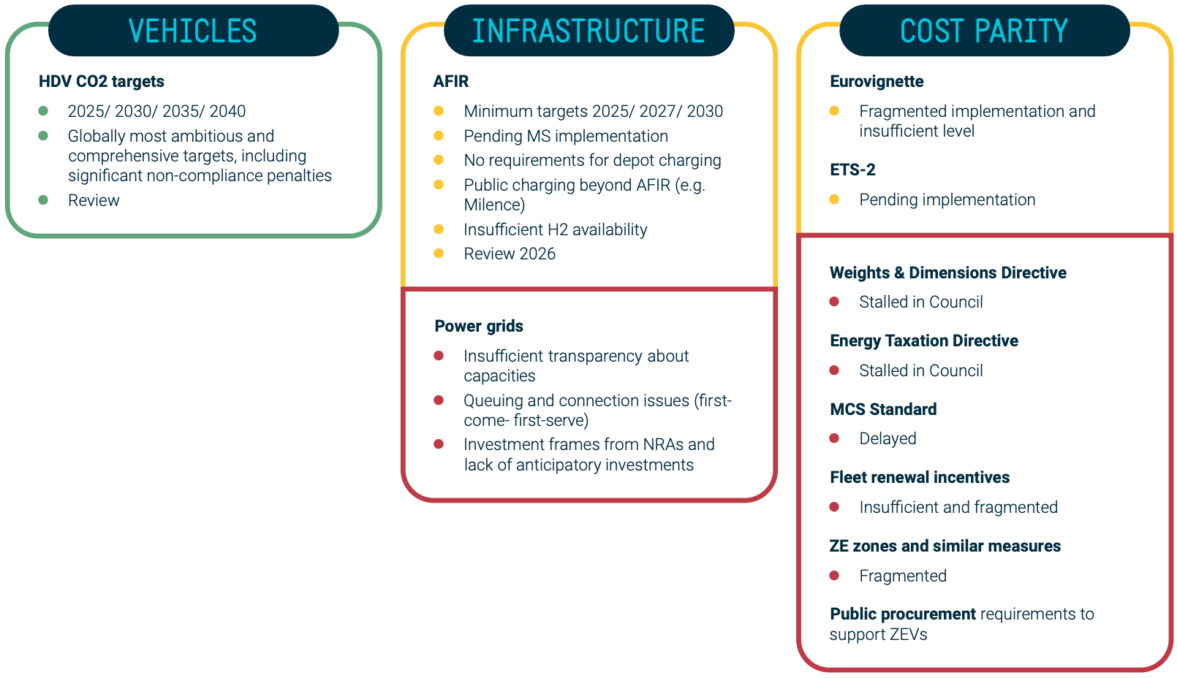
ZEV TRANSITION: QUO VADIS?

Slide 20
How to Accelerate the transition?
from ambition to execution
Move faster on enabling conditions
  Scale up HDV infrastructure: public/ depot charging, hydrogen
  Close the TCO gap to unlock demand: strengthen demand drivers, e.g. Eurovignette, Weights & Dimensions, fleet renewal, public procurement…
Apply pragmatism to the regulatory framework where needed
  Fine-tune rules based on real-world experiences and deployment
  Maintain clarity, predictability and investment certainty
Put the market at the centre
  Focus on real business cases, not theoretical pathways
  Build momentum through scale
Scale. Scale. Scale…

