Slide 1
EU legislation on weights & dimensions of heavy-duty vehicles
Transfrigoroute International Annual Meeting
24 June 2026

Slide 2

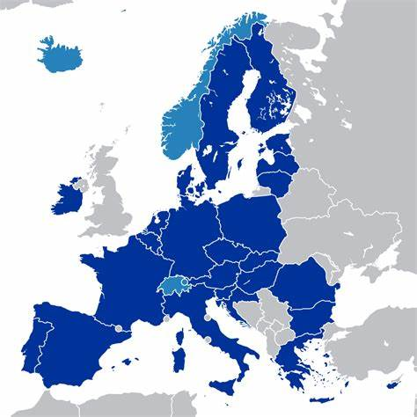







W&D: Why do we need to act?
DECARBONISATION
INTERNAL
MARKET
COMPLIANCE
Low uptake of ZEV and aerodynamic devices;
Insufficient support to intermodal transport
Patchwork of national and international rules for longer and heavier HDVs
Inefficient and ineffective enforcement

Slide 3

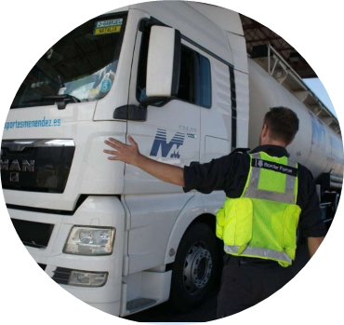

Objectives of the revision of the W&D directive
Decarbonisation of freight transport
Efficient and fair internal market
Compliance with EU rules
Removing barriers for the uptake of ZEV and energy-saving technologies
Incentivising intermodal transport
Harmonising the rules on maximum W&D of HDV in cross-border operations
Improving the effectiveness and efficiency of enforcement in cross-border operations

Slide 4





What we propose:
Decarbonisation measures
Remove barriers to the uptake of ZEV and grant additional payload
  weight, axle-weight and length: 4 t/ 90 cm for ZEV
  other vehicles within scope: trailers and buses
  indirect support to improved aerodynamics
Support intermodal transport
  Alignment with CTD: 4t more for all multimodal transport
  extra height (30 cm for high-cube containers)
  Smart compliance: eFTI platforms
  Compatibility of semi-trailers with
  road-rail transport
40t / 42t ZEV
40t / 44t ZEV
90cm ZEV
44t / 46t ZEV
  44t / 48t ZEV
4.3m

Slide 5
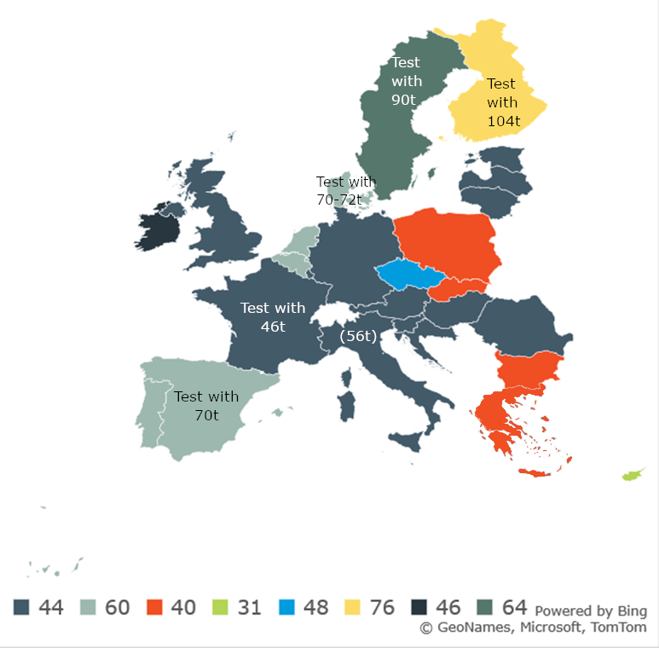

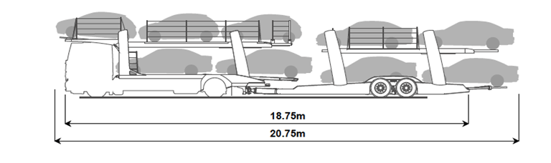
What we propose:
Harmonisation
European Modular System between allowing MS
44-t HDV between allowing MS (temporarily)
Loaded length of vehicles transporters (20.75m)
Streamlining procedures and requirements for indivisible loads

Slide 6
Enforcement measures &
Crisis-proof
Minimum level controls (6 per million vehicle-Km)
Minimum deployment of Weigh-In-Motion systems ( every 300 km TEN-T )
Intelligent Access Policies ( i.e.: geofencing)
Information and monitoring systems for EMS and trials
Increasing Resilience: Temporary exceptions for crisis situations

Slide 7
European Parliament position 1/2
Zero-emission heavy-duty vehicles:
  Extra weight/axle weight for etrailers, 3-axle ZE buses and tandem axles
  Extra length: unlimited, protecting driver’s comfort
Intermodal transport:
  Extra weight for 2+3-axle combinations involved in IT (from 42t to 44t)
  Extra length for articulated vehicles involved in IT: 18m
Enforcement: WIMs for direct enforcement
Revenues from penalties to be used for a smart & sustainable transport, including encouraging intermodal transport operations

Slide 8
European Parliament position 2/2
European Modular Systems:
  Prior impact assessment for new trials/routes and subsequent measures
  Mutual recognition of EMS driver’s certificate
EU label for long vehicles >= 18.75m
Cross-border traffic of 44t lorries
Indivisible loads
  EU harmonised application form and EU one-stop-shop
  Electronic permits

Slide 9
Council position 1/2
SUSTAINABLE TRANSPORT
Zero-emission heavy-duty vehicles:
  No extra axle weight and the extra weight of 44t is limited to 3+3 ZEVs
  No extra weight for ZE trailers
  Intermodal transport
  Extra weight of 2+3 and 3+2 HDVs in intermodal is limited to +2t
  Cumulative weight intermodal + ZEVs: 46t
  Cross-border traffic of heavier ZEVs/IT

Slide 10
Council position 2/2
HIGH-CAPACITY VEHICLES:
  Derogations Article 4: forestry industry, 7+ axle HDVs
  EMS
  Shuttle transport
ENFORCEMENT:
Status quo on roadside controls, IAP and eFTI
OBMM for enforcement purposes for ZETs

Slide 11
State of Play
European Parliament First Reading: 12 March 2024
Council General Approach: 4 December 2025
First shake-hands trilogue: 9 December 2025
2nd trilogues: 11 June 2026
  Agreement on Indivisible loads, vehicle transporters, EMS, emergency clause, EU label, national OSS
  Pending: Extra weight for ZEVs, X-border of 44t HDVs and enforcement
Expected adoption: T2 2026

Slide 12
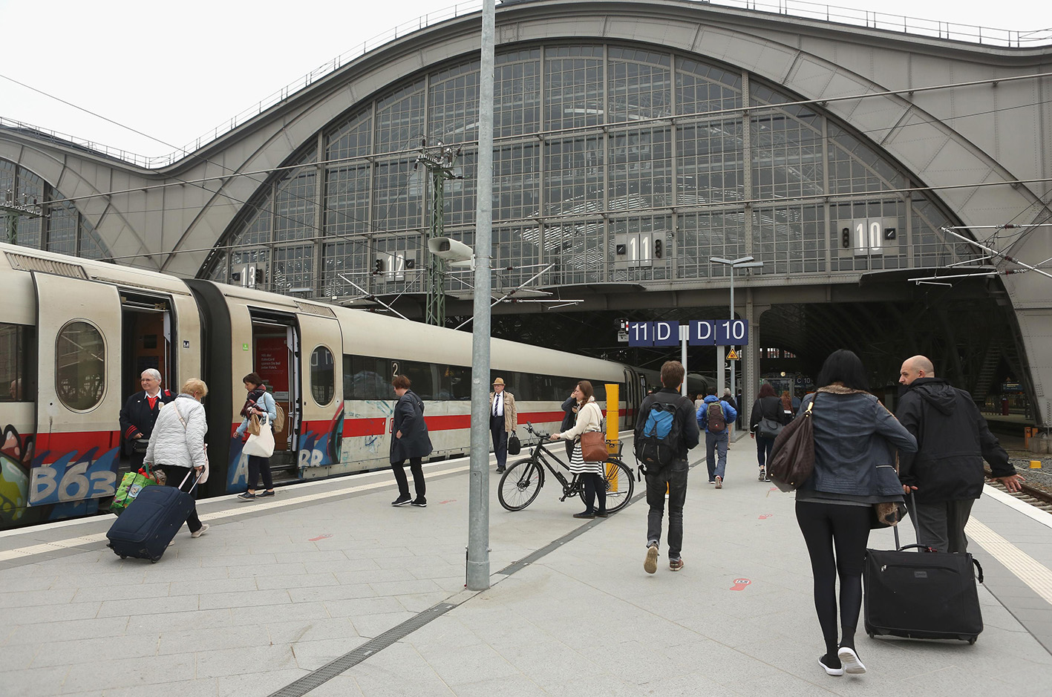

Thank you

